Slide 1


Team Code Brigade 1.0
Amrutvahini College Of Engineering , Sangamner

Slide 2
Problem statement :- Water Accounting In Irrigation Commands Through Crowd Sourced Crop Mapping.
Problem Statement ID :- SK155
Ministry :- Central Water Commission , Ministry Of Jal Shakti

Slide 3
For Proper Management Of Water For Irrigation Purpose We Have Come With An Idea Which Provide The Average Water Required For A Specific Crop Region Taking Various Water Resources In Account.
For This Idea Is As Follows :-
Idea :-
The Data Could Be Collected From Various Outsources (Farmers) And Would Be Stored In The Database.
The Database Would Be Used For Analysis.
The Analysis Will Provide A Excel Sheet And a Pie-Chart Of The Average Water Required.
Excel Sheet Will Make The Evaluation Easy To Understand.

Slide 4
What Will Help For Analysis :-
The Field Size As Per The Outsource (Farmers ).
The Standard Water Requirement Database .
The 7/12 Utara Provide By The Farmer .
Image Of The Crop Collected From Farmers .
Proper Authentication Of A User .
The dashboard With All Database Handled By Admin.
Various Information Collected From Farmer for.e.g type of soil,humidity,stage of crop growth etc

Slide 5
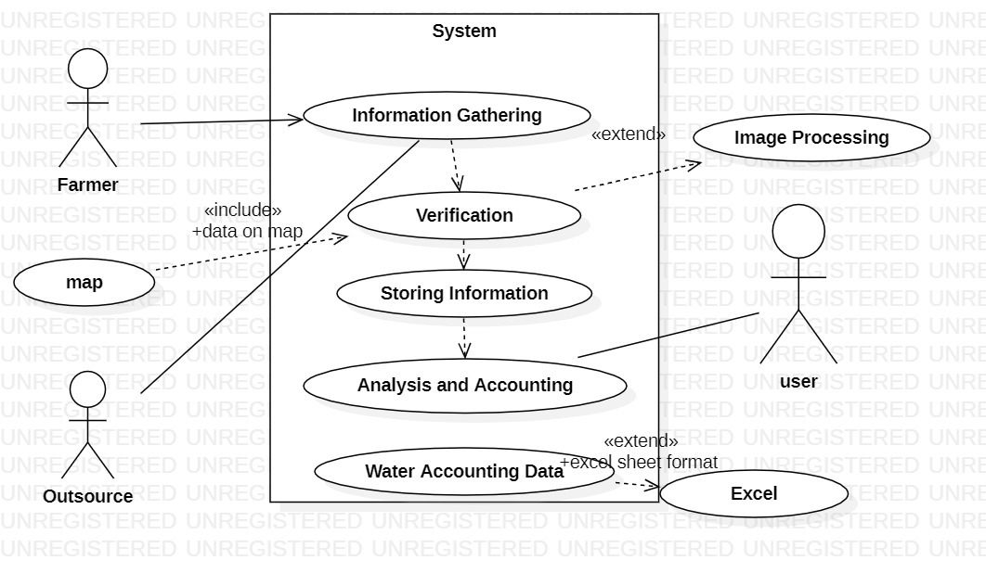
System Will Work As :-
Step 1 : Collect Data From Outsource
(Data – 7/12 Utara , Image , Area Of Field .) .
Step 2 : Authentication The Data .
Step 3 : The Verification Of Plant would be done with the help of deep learning.
Step 4 : Data Area , Crop And Requirement Of Water Will Be Compared With Standard Database .
Step 5 : The Analysis Of Data Will Be Shown In The Form Of ` Excel Sheet and pie chart .

Slide 6
The Uniqueness :-
The Data Can Be Update Every 3 Months As Per The Crop Varies .
Easy To Evaluate And Analyses.
Would Provide The Average Water Required For The Specific Region As Per Crop.
Highlights :-
Average Water Usage For A Specific Region .
A Total UI Based (Easy To Use For Farmers /Outsources ).
The Result Displayed In Excel Sheet Easy To Evaluate .
This Will Help us For Proper Water Management .
One Step Towards The Revolution In Water Accounting .

Slide 7
THANK YOU

